Slide 1
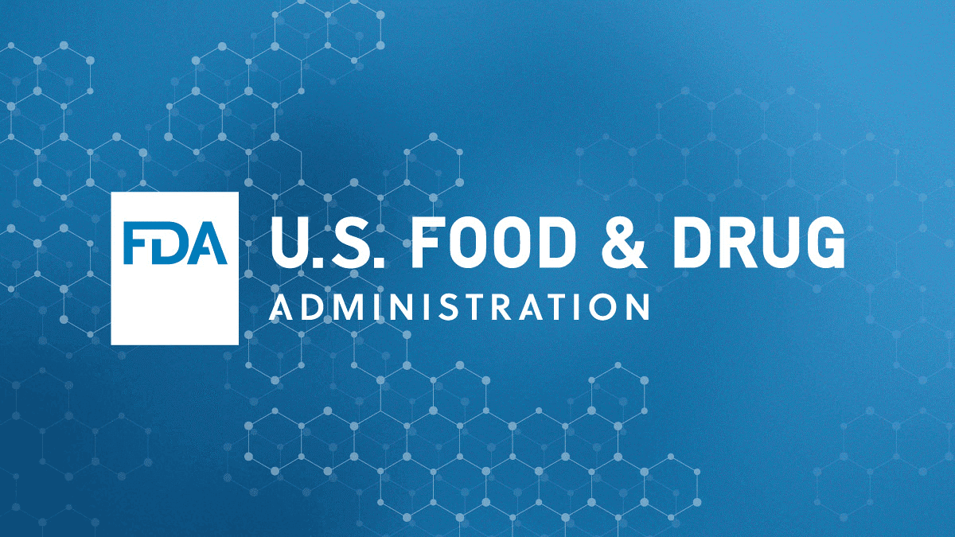
DATA ANALYSIS OF FDA
Dr. JUNAID MUHAMMED SHAIK

Slide 2
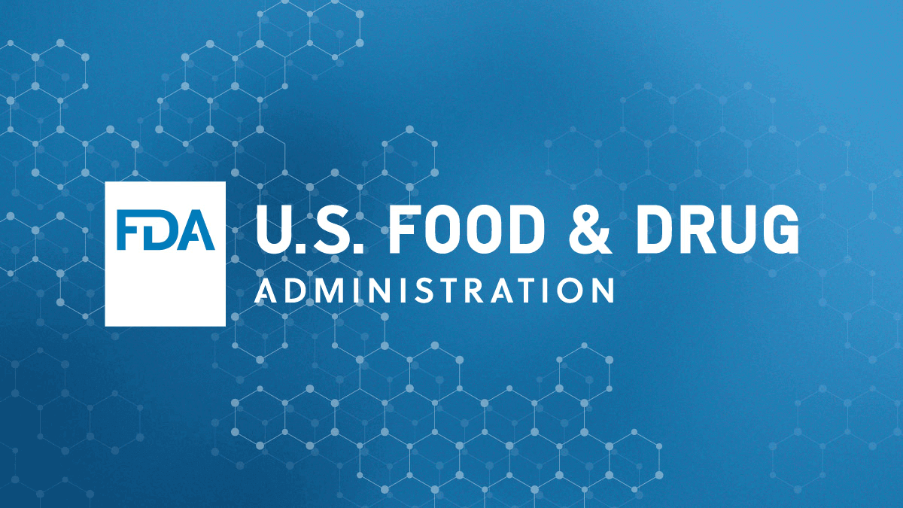
INTRODUCTION
The United States Food and Drug Administration (FDA or US FDA) is a federal agency of the Department of Health and Human Services. The FDA is responsible for protecting and promoting public health through the control and supervision of food safety, tobacco products, caffeine products, dietary supplements, prescription and over-the-counter pharmaceutical drugs (medications), vaccines, biopharmaceuticals, blood transfusions, medical devices, electromagnetic radiation emitting devices (ERED), cosmetics, animal foods & feed^{[3]} and veterinary products.
From the data given, first the required objectives are achieved using sql, then the visualizations are generated using powerbi, using these the following ppt is created.

Slide 3
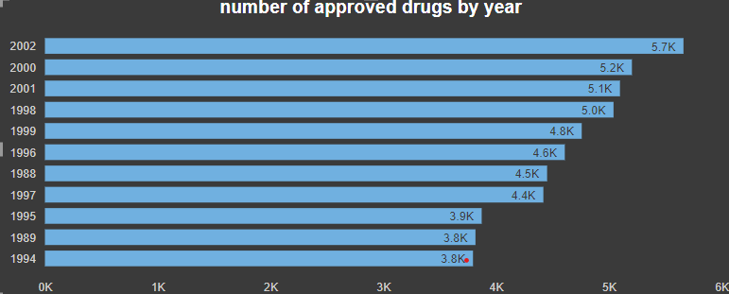
the data contains information of multiple drugs, their sponsor applicants ,approval year, and its product market status, starting from the year 1939 to 2016.
Now, lets get into detail
from the above image we can understand that years 2000,2001,2002 are top 3 in terms of number of drugs approval

Slide 4
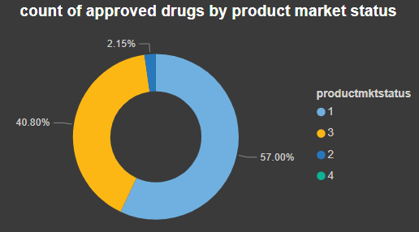
From this image it is clear that the majority of drugs which are being approved belong to the product market category 1, followed by category 2.
So with this we can draw the conclusion that,the higher the product market status, the higher are its chances of getting approved by the FDA.

Slide 5
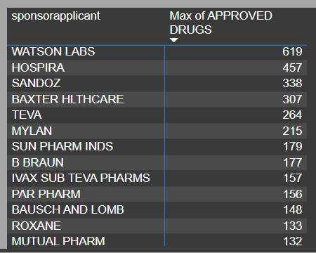
Each application before entering into the approval process of FDA, it is sponsored by some pharmaceutical company, this company does the required R & D of the application and submits the final format for the approval of FDA .
Here are some of the most successful pharmaceutical companies with highest approval rates.

Slide 6
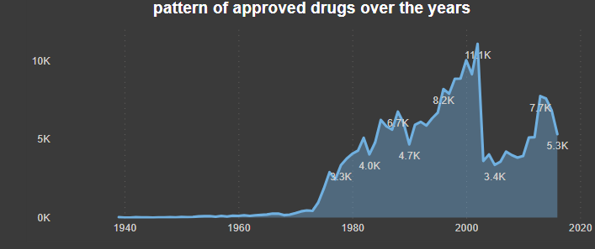
This graph talks about the number of successfully approved drugs over the years,
There is a gradual increase in the number of approved drugs from the late 1970’s to the early 2000’s.
After the year 2002 we can see a dip in the number of approved drugs.

Slide 7
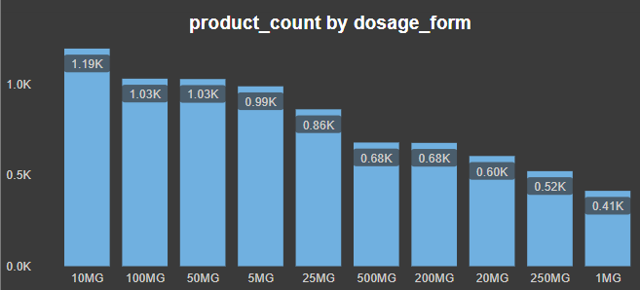
Let’s talk about the best selling dosage form , here is a chart showing us the highest number of products selling in the market and in which dosage form they are available, clearly 10mg is the most preferred dosage form.

Slide 8
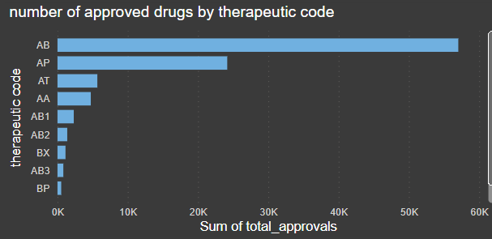
Each drug application has its won defined therapeutic evaluation code, and the most successful therapeutic evaluation code is:
﻿At 57031, AB had the highest Sum of total approvals and was 14,868.77% higher than AO, which had the lowest Sum of total approvals at 381.﻿﻿ ﻿
﻿Across all 10 therapeutic code, Sum of total approvals ranged from 381 to 57031.

Slide 9
conclusion
The top three 3 years in terms of approval are 2000,2001,2002
The bottom 3 years in terms of approval are 1943,1944,1945
The highest approved sponsor applicant is ‘Watson labs’
Product market status and approval status are directly proportional to each other.
There is a clear gradually increasing pattern in terms of approval from the late 1970’s to the early 2000’s
After 2002 there is a sharp decline in the number of drugs getting approved
The most preferred dosage form is 10mg
The most successful therapeutic evaluation code is “AB”

Slide 10
THANK YOU

